Slide 1
Innovative test solution
Provider
- Probe pin Datasheet -

Slide 2
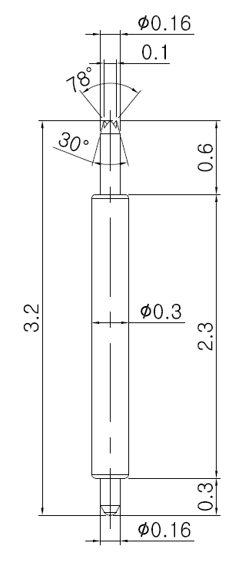
※ Special – POGO pin for High speed
IVB-DAR-320-030-A148-00
Pitch | 0.4 mm
Total Length | 3.2 mm
Use Length | 2.75 mm
Use Stroke | 0.45 mm
Spring Force at Use Stroke | 22 gf at 0.45 mm stroke
Operating Temperature | -40 to +120℃
DC Resistance | Under 100mΩ at 0.45 mm stroke
Current Rating | 1.4 A
Self Inductance | 0.87 nH
Bandwidth @ -1dB | 20.2 GHz
Top Plunger | BeCu / Au
Bottom Plunger | BeCu / Au
Barrel | Pb / Au
Spring | Music Wire / Au
Insertion Life | 1,000,000 cycles

Slide 3
Thank you.

